Slide 1
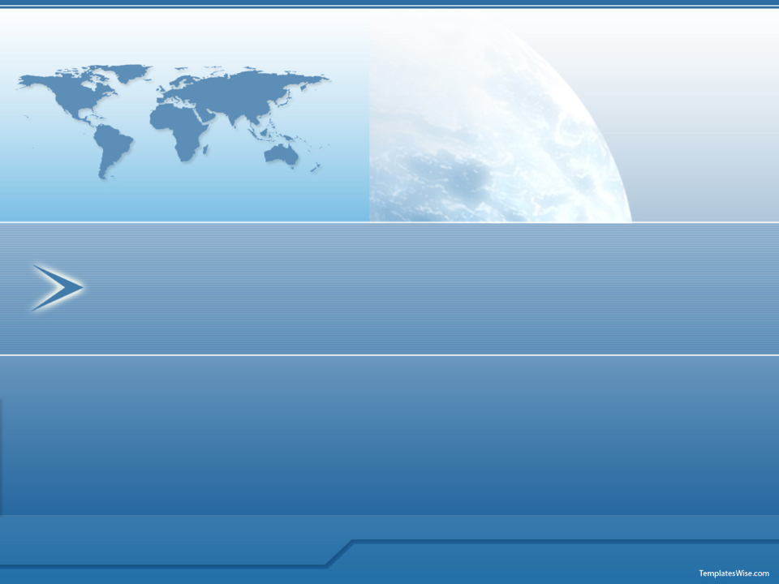
CRM
University of Aegean
Dpt. of Financial Engineering and Management
Ioanna Anastasaki
Dragonas Konstantinos

Slide 2

Definition of CRM
Customer Relationship Management (CRM) is:
the integration of sales, marketing, service and support strategy, process, people and technology to maximize customer acquisition, value, relationships, retention and loyalty.
The resulting information mosaic is then used to create and automate a variety of processes that identify, and describe, valuable customers. Most important, these processes help you personalize new and ongoing interactions to cost-effectively acquire, stay close to, and retain these "good" customers.
CRM is a part of the marketing and sales segment of the value chain

Slide 3

CRM is about to creating value for the customers
CRM itself is not a technology, even though technology is required to enable CRM
Technology makes it possible to integrate the large volumes of customer information(data) that are required for CRM and to efficiently transform this information into useful knowledge (value)
Technology also enables a company to ineract with its customers in ways that provide value to the customer, as well as make it easier for the customer to do business with them.
Tuesday, November 2, 2010

Slide 4
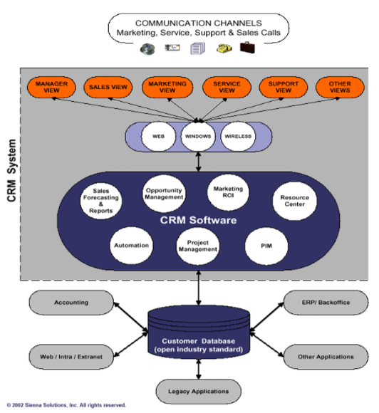
Tuesday, November 2, 2010

Slide 5






Model of Customer Relationship Management
Relationship marketing inputs
Understanding customer expectations
Building service partnerships
Empowering employees
Total quality management
Relationship marketing outcomes
Customer Satisfaction
Customer loyalty
Quality products
Increased profitability
Assessment state
Customer feedback
Integration
Tuesday, November 2, 2010
(Evans and Luskin, 1994)

Slide 6
CRM Strategies
Customer Acquisition
Gain the greatest number of new “Best” customers as early in their “lifespan” as possible.
Customer Retention
Retain and expand your business and relationships with your customers through up-selling, cross-selling and servicing.
Customer Loyalty
Offer programs to ensure that your customers happily buy what you offer only from you.
Customer Evangelism
Enable loyal customers to become a volunteer sales force.
Cost Reduction
Reduce costs related to marketing, sales, customer service and support.
Improve Productivity
Enhance your e-business strategies.
Tuesday, November 2, 2010

Slide 7
Managing Customers Relationship
Developing the relationship
Select an appropriate offering
Customise the relationship
Link the solutions with the customer’s needs
Disuss customer concerns
Summarize the solution to confirm benefits
Secure commitment.
Tuesday, November 2, 2010

Slide 8
Type of CRM and analysis
Types of CRM
Degree Of Customer Connectivity
High | Many to One | Many to Many
Low | One to One | One to Many
 | Low | High
Degree of Business Connectivity
Tuesday, November 2, 2010

Slide 9
When does it make sense to invest in business
Connectivity?
– The firm should have a good access to customers and a good understanding of an entire range of customer needs.
– It should be easy to aggregate products and services from partner firms into the right bundles for the right customer
Tuesday, November 2, 2010

Slide 10
When does it make sense to invest in customer networking?
– The customer must perceive greater value to be part of the network than to be out of it
– The firm must recognize additional value from serving the customer network (as opposed to serving individual customers)
Tuesday, November 2, 2010

Slide 11
Functions of Customer Relationship Management
Direct functions (are the basic requirements of a company that are
necessary to survive in the competitive marketplace)
Profit
Volume
Safeguard
Indirect functions (are the actions necessary to convince the
customer to participate in various marketing activities).
Innovation
Market
Scout
Access.
Tuesday, November 2, 2010

Slide 12





Functions of Customer Relationship Management
Value Creation Process
Technology delivery process
R&D
Technology integration
Efficiency, effectiveness
learning
Management
Decision
Process
Customer sensitivity
Diversity
Information
Differentiated
offering
Value-based
Strategies
Pricing
Communication
Product delivery process
Concept to launch
Manufacturing process
Customer delivery process
Supply chain
Distribution
Infomediation (distribution
of information)
Tuesday, November 2, 2010

Slide 13
Piraeus Bank CRM example
Improved customer service, leading to happier customers was one goal, but increasing revenues per customer was vital to the bank’s success. The Misys core banking solution, Misys Equation, is a crucial component within Piraeus Bank’s Customer Relationship Management (CRM) strategy, where it underpins tailor-made CRM applications. The Misys software ensures that critically important customer data and transactional information is available whenever and wherever needed. Mobile, internet and call centre banking, electronic brokerage, consumer lending and asset management systems are all fed with this information to help customers benefit, and staff deliver, excellent service. Since going live, the successes have been significant, particularly in the area of call centre cross selling.
Tuesday, November 2, 2010

Slide 14
Pireaus Bank CRM example
Misys software has helped Piraeus Bank to launch new products and services, for example enabling the introduction of a pioneering automated lending system. Covering a wide range of products, including mortgages, car and general consumer loans, today the system receives over 3,000 applications every single day.
Tuesday, November 2, 2010

Slide 15
Summary
CRM is a new business philosophy based on trust and value
The core function of CRM is the value creation process
Customer relationships develop over time
The role of global salespeople in the process is that of both
relationship builders and relationship promoter
The basic premise of CRM is to offer superior value to
customers in an effort to turn prospects into
customers, customers into loyal customers, and
loyal customers into partners.
Tuesday, November 2, 2010

