Slide 1


TIMES Committee
How to approach a case study

Slide 2




Agenda
What a Case Study is
About TIMES
Structuring the case work
  Identifying the problem
  Analysing the case
  Evaluating options
  The recommendation
Presentation
  What is expected?
How to approach a case study
TIMES Committee | Slide 2

Slide 3
What a Case Study is and where it comes from
A case study is a description of a tough business situation that helps the reader understand business challenges more in-depth
The case study method has widely been used and promoted by Harvard Business School in advanced management teaching
“The goal of Harvard Business School is to prepare students for the challenges of leadership. We believe that the case method is by far the most powerful way to learn the skills required to manage, and to lead” – HBS
How to approach a case study
TIMES Committee | Slide 3

Slide 4
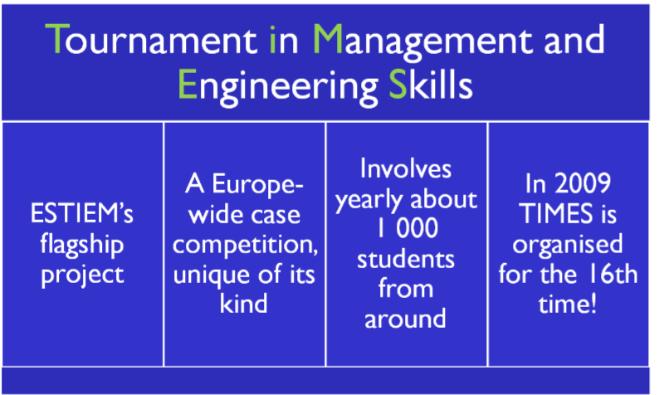
What is TIMES?
How to approach a case study
TIMES Committee | Slide 4

Slide 5
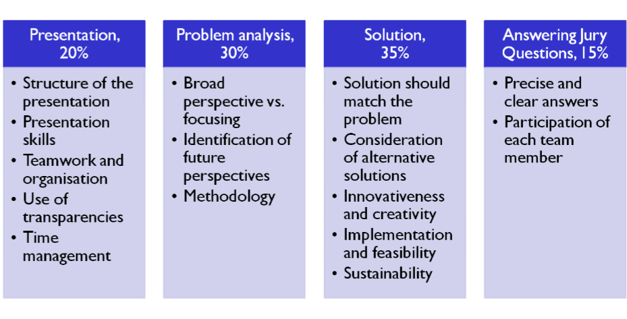
How is TIMES Judged?
How to approach a case study
TIMES Committee | Slide 5

Slide 6
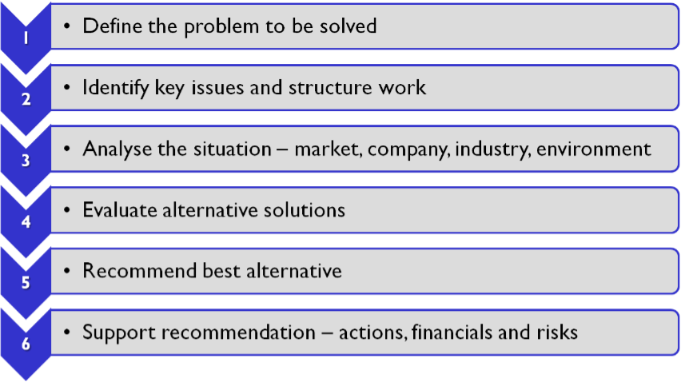
An example of structured work
How to approach a case study
TIMES Committee | Slide 6
Notes:
Demonstrate each one on a flipchart

Slide 7
What is the Problem Statement?
It is …
  … a thought-provoking question written explicitly, not a fact or assertion
  … clear, concise, specific, not general and unambiguous
  … actionable, not academic
  … broad enough to not unduly limit following analyses
  … if needed, updated as your analysis progresses
  … includes all problems faced and not just focuses on one
For example:
  How should Microsoft keep growing profitably?
  How should Innocent drinks refocus their strategy?
  How should Samsung react to the competition from China?
How to approach a case study
TIMES Committee | Slide 7

Slide 8

Identifying key issues and prioritising
Key Issues
  What are the problem areas in the case?
  What are the key questions that need to be answered?
Prioritising
  Distinguish critical problems from secondary problems
  Potential impact vs. likelyhood of occurrence
+
Impact
-
-
Probability
+
How to approach a case study
TIMES Committee | Slide 8

Slide 9
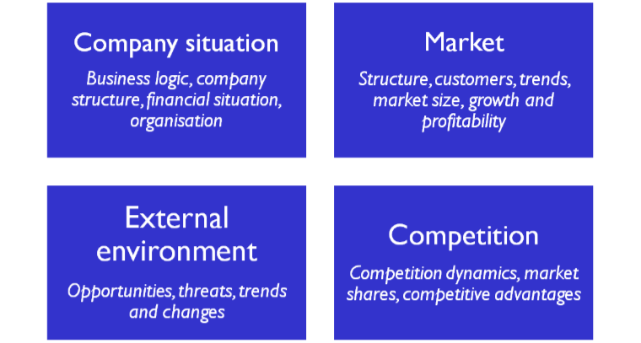
Analysing the situation
Use quantification whenever possible!
How to approach a case study
TIMES Committee | Slide 9

Slide 10
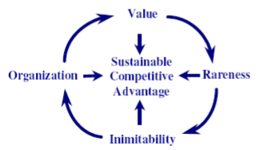

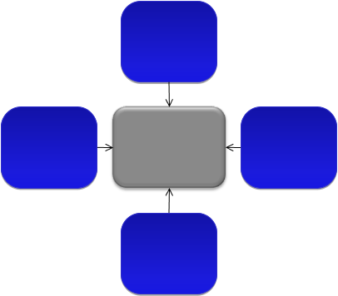

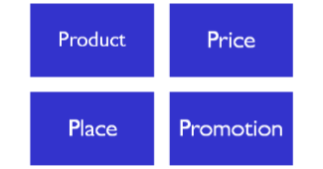
Common analysis frameworks
VRIOS framework:
Sustainable competitive advantage
Porter’s five forces:
industry attractiveness
However, usually the best approach is to develop a case-specific framework of your own, that suits the case perfectly
Threat of new entrants
Bargaining power of suppliers
Industry competition and rivalry
Bargaining power of customers
Marketing 4P’s:
Evaluating marketing strategy
Threat of subsititute products
How to approach a case study
TIMES Committee | Slide 10

Slide 11
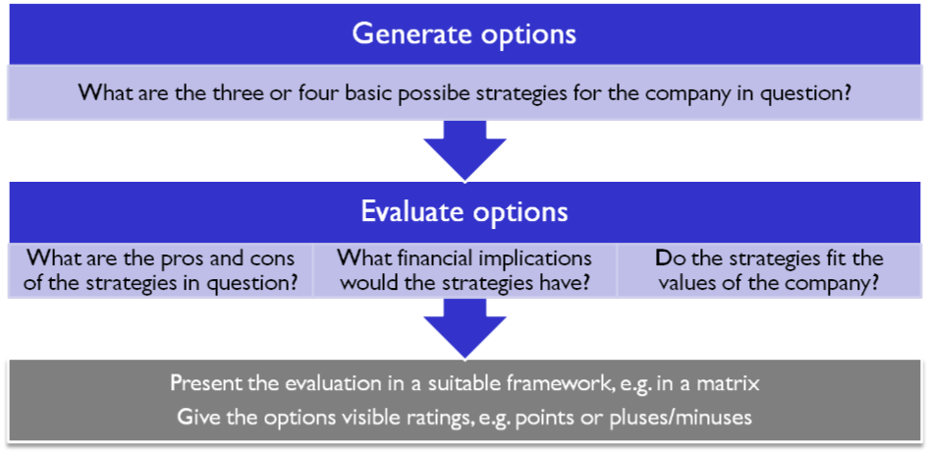
Generate and evaluate alternative solutions
How to approach a case study
TIMES Committee | Slide 11

Slide 12
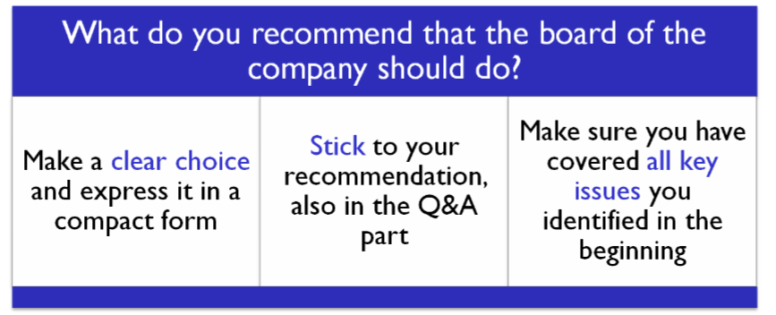
Giving the Recommendation
Charachteristics of a good recommendation:
Solid and understandable
Identification of all key issues
One final solution
Feasible
Actionable and implementable
Sustainable
Quantified
How to approach a case study
TIMES Committee | Slide 12

Slide 13
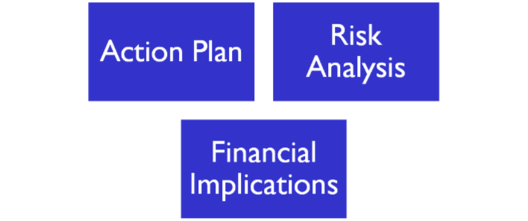

Don’t Forget to Support your Recommendation
Presenting these parts gives you more time to convince the judges that your recommendation is superior!
How to approach a case study
TIMES Committee | Slide 13

Slide 14
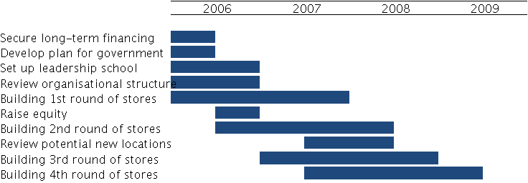
Example of Action Plan
How to approach a case study
TIMES Committee | Slide 14

Slide 15
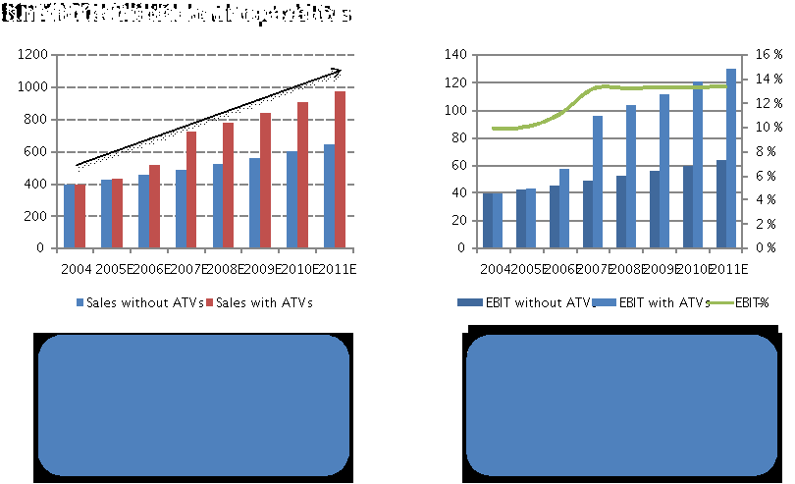
Example of Financial Implications
How to approach a case study
TIMES Committee | Slide 15

Slide 16

Example of Risk Analysis
Risk | Probability | Implication | Contingency
Competitor captures market |  |  | - Tailored product concept, monitor competitor movements, focus on R&D
Consumers confused of mixed position |  |  | - Clearly different brands for different segments
Technology fails / reliability poor |  |  | - Extensive R&D to increase quality, warranties and guarantees keeping customers happy
Plumbers will not accept the product |  |  | - Move to consumer-targeted advertising
B&Q chooses not to collaborate |  |  | - Change retailers, negotiate new deal
Product still fails to sell |  |  | - Concentrate efforts on premium segment, harvest and exit
Demand exceeds capacity |  |  | - Plan capacity increase already, increase price, concentrate on premium segment
How to approach a case study
TIMES Committee | Slide 16

Slide 17
Presentation
What we expect to see:
  What are the main issues to consider? (problem)
  Which ones are most important? (prioritization)
  What are your ideas? (work)
  How would you proceed? (recommendations)
What do we not expect to see:
  Repetition of basic background facts from the case
  Uneven time distribution between team members – keep a balanced presentation!
  Too much information on the slides – keep them simple and clear
  Too long/too short presentation – do not go over your time limit!
How to approach a case study
TIMES Committee | Slide 17

Slide 18


Any Questions?
Nora.Rosendahl@estiem.org
Luis.Godinho@estiem.org

